Slide 1
Be on time
Be interactive
100% or nothing
Do all daily challenges
CLASSROOM RULES

Slide 2
REVIEW

Slide 3

GRAMMAR + VOCABULARY

Slide 4
LISTENING
How was your vacation?
I went for the sunshine, but it rained every day! So I couldn’t get a tan.
Did you do anything interesting on your vacation?
How was your trip to Thailand?
I went out of town for a few days. I visited my brother and his family.
When did you get back from your trip?
I rented a house in the country. It was really quiet and peaceful.
It was so crowded everywhere. We couldn’t even get a hotel room.
It was terrible. The food was awful. And the hotel wasn’t clean at all.
It was fantastic. The weather was perfect.

Slide 5
SPEAKING
Do you love travelling? Why?
Tell me about one trip you remember the most.

Slide 6
Lesson 14 LEISURE
Brought to you by LangGo

Slide 7
OBJECTIVES
01
02
Grammar
Speaking
Future simple
Be going to
Describe a trip

Slide 8
01
GRAMMAR

Slide 9

FUTURE SIMPLE

Slide 10
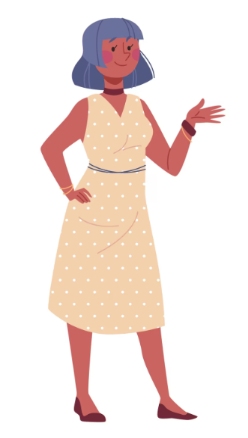
USAGE
To make predictions, usually based on our opinions or our past experience.
Ex: I think it will be extremely hot there.
To talk about future events we haven’t arranged yet.
Ex: After we arrive, we will find a local restaurant for dinner.
To talk about something we decide to do at the time of speaking
Ex: Oh no, I forgot my passport! I will go back to the hotel to get it.

Slide 11
STRUCTURE
Positive
Interrogative
S+ will + Vinf
Will + S + Vinf ?
I think it will be a perfect trip for us to relax and forget about work.
Will we rent a bicycle to ride around the lake in the morning?
Negative
Question
S+ will not + Vinf
WH + will + S + Vinf + …?
My friends and I won't just eat at big restaurants; we want to try street food.
Who will you go with on this exciting trip?

Slide 12
BE GOING TO

Slide 13
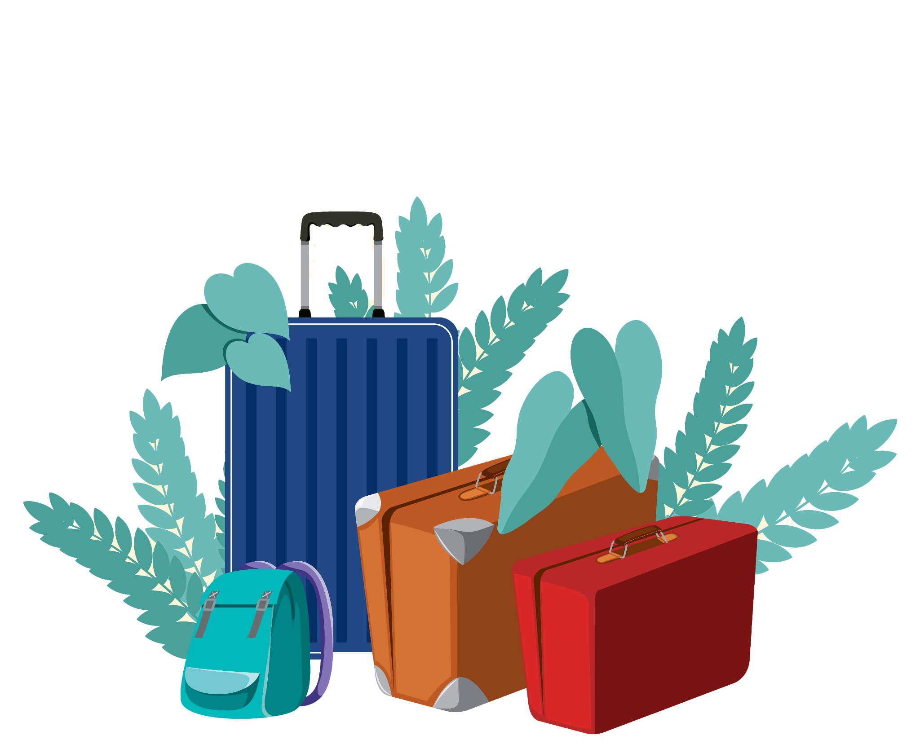
USAGE
We use “BE GOING TO”:
To talk about future events we have already thought about and intend to do.
To make predictions when there is present evidence.
Example: We’re going to stay at the Grand Hotel.
Example: We’re certainly going to have an exciting trip.

Slide 14
STRUCTURE
 | Structure | Example
Positive | S + am/is/are + going to +V. | She is going to be late for the train.
Negative | S + am/is/are not + going to +V. | We aren’t going to go on a trip.
Interrogative | Am/is/are +S + going to +V? | Are you going to buy the ticket?
Question | Wh-word + am/is/are +S + going to +V? | What are we going to do on our holiday?

Slide 15
FUTURE SIMPLE VS BE GOING TO
Future simple
Be going to
Prediction based on personal opinion
I think finding a good hotel in the city center will be expensive during peak season.
Instant decisions and future plans we haven’t arranged yet
I think I will visit Da Lat sometime next year.
Prediction based on present evidence
All the hotels listed online are fully booked for next month! It's going to be very difficult to find a room.
Future plans and decisions we have thought about and intend to do
I am going to visit Da Lat next summer. I've already booked my flight.

Slide 16
EXERCISE : future simple tense or be going to
are going to do
Emma: Hi Ben! What (1) _______ you __________ (do) this summer?
Ben: I (2) ________________ (visit) my cousins in Hanoi. We’ve already booked the train tickets.
Emma: Nice! I think I (3) __________ (stay) in the city. I haven't made any plans yet.
Ben: Oh, then maybe I (4) __________ (send) you some photos of the trip!
Emma: Thanks! Oh, by the way, I (5) _______________ (go) on a trip with James and Vivian next weekend. Do you want to come with us?
Ben: Thanks, but I need to stay at home to pack my clothes. I’m not sure what to bring though. Maybe I (6) __________ (ask) my cousin what the weather is like.
Emma: Good idea. I'm sure it (7) __________ (be) very hot in Hanoi in the summer!
Ben: Yeah, I think I (8) __________ (take) only light clothes and sunscreen.
am going to visit
will stay
will send
am going to go
will ask
will be
will take

Slide 17
02
SPEAKING

Slide 18
Describe a trip you would like to take in the future
Where would you like to go? Why? (Place)
Who will you go with? (People)
How will you get there? (Means of transport)
What will you do there? (Activities)
How will you feel about the trip? (Feelings)

Slide 19
Describe a trip you would like to take in the future
I want to talk about a trip I am going to take in the future.
I want to go to Da Lat because I love its cool weather and beautiful nature. I think it will be a perfect place for me.
I am going to go with my best friends. We are going to travel by car because it is comfortable. It will take us about 6 hours to get there.
When we arrive, we are going to check in a nice homestay. Then, we will explore the city. We are going to visit Xuan Huong Lake and the Flower Garden and take a lot of photos. We are also going to try many local foods like hot pot and fresh fruits. I think the food will be amazing!
I won't try to visit too many places in one day because I want to enjoy the peaceful feeling.
I hope we will make many good memories.
I am really excited about this trip, and I hope we will go there next month.

Slide 20
Speaking time

Slide 21

GOODBYE!
Don’t forget to complete your daily challenges!

